Slide 1
Chacha20 Poly1305 Analysis
In Trezor One firware 1.12.1 version

Slide 2
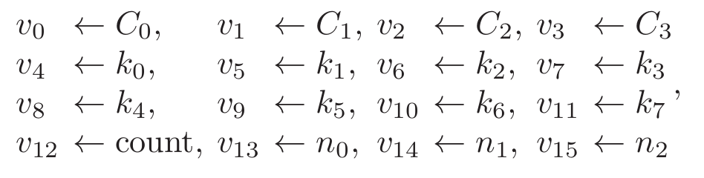
Working mechanism of chacha20 poly1305 based on RFC7539
- The initial state of ChaCha20 is set to the following values:
C0 to C3 => Pre-defined constant (96 bit)
k0 to k7 => Key (256 bit)
Count => Block Counter (32 bit)
n0 to n2 => Nonce (96 bit)

Slide 3
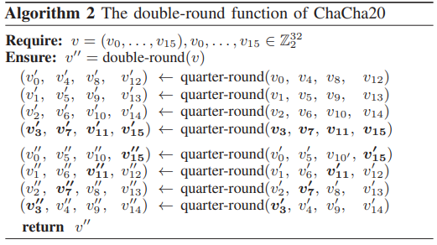
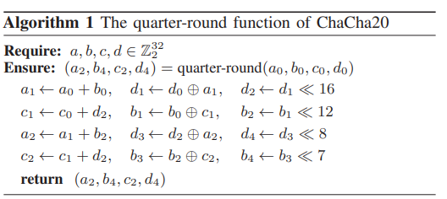
Working mechanism of chacha20 poly1305 based on RFC7539
- The initial state of ChaCha20 is set to the following values:
- We will run Algorithm 2 for 10 times and we xored generated output (state20) with the initial state0 of chacha20.
- So an output block of ChaCha20 is generated by computing (block<= state0 + state20)
- Now we are going to encrypt 512 bit plain-text For that we generate key stream by resulting block and xored with plain-text
- For remaining data we increment counter and repeat same process.

Slide 4
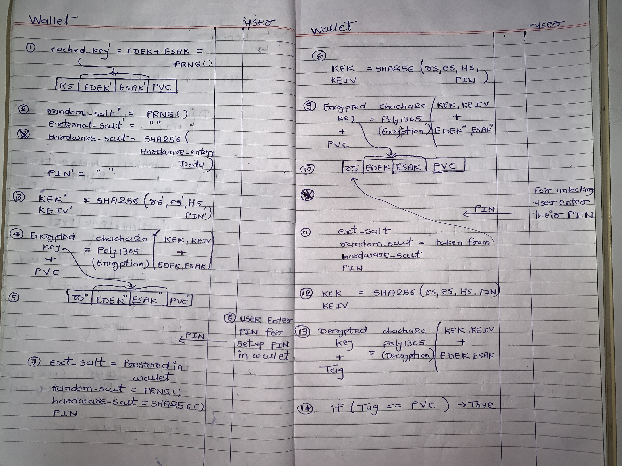
Comparing ChaCha20 algorithm with the wallet encryption algorithm
-
Standard Chacha20 | Implemented Chacha20
C0 to C1 (Constant) | constant
K0 to k7 (key) | KEK
Count | count
Nonce | IV (intialization Vecotr)
Plain text | EDEK, ESAK

Slide 5
Research paper : EM base side channel attack on ChaCha20
1) Generated 50K Power Traces and stored in ine file
Plaintext 1 → PowerTraces 1
Plaintext 2 → PowerTraces 2
.
.
Plaintext n → PowerTraces n
2) Calculate NICV and using NICV they only select relevant leakage sample point from all power trace’s point.

Slide 6
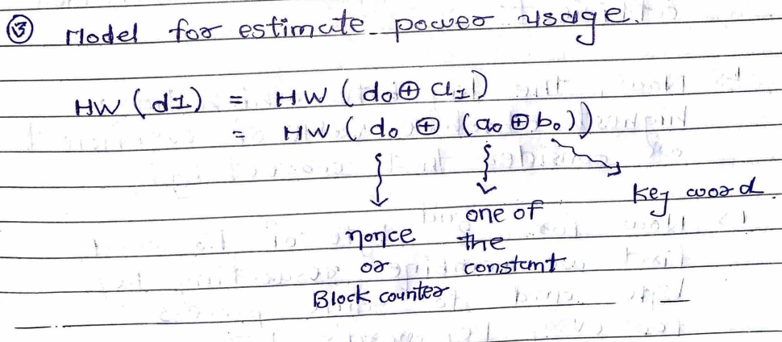
Research paper : EM base side channel attack on ChaCha20

Slide 7
Research paper : EM base side channel attack on ChaCha20
Generate key hypotheses for each keyword (K0-K7), where each keyword is 32 bits long.
Utilize a divide and conquer approach by first selecting 1 byte of the LSB from K0.
Generate all key hypotheses for the selected byte, ranging from 0 to 255.
Estimate power usage using a hamming weight model.
Calculate the Pearson correlation coefficient for each key byte.
Identify the key byte with the highest absolute value of the coefficient as the correct key guess.
Combine the resulting key byte with the next byte of K0 word.
Repeat the process for each byte of every keyword (K0-K7).

Slide 8
My Point of view about replicate this attack on crypto wallet

Slide 9
My Point of view about replicate this attack on crypto wallet
For this attack, we need to know the parameters:
a0 – One of the constants (known to the public)
bo – Key word (in this case, KEK, which is our target)
do – Nonce (in this case, KEIV) (KEIV is not a public parameter and depends on values like PIN, Random Salt, Hardware Salt, and External Salt)
Let's assume that using the method from a previous paper, we manage to obtain KEK. Even if we acquire KEK, how can we find the PIN or bypass the PIN?

